Slide 1
Cat bond pricing under a product probability measure with POT risk characterization
Qihe Tang And Zhongyi Yuan

Slide 2
Propose a general pricing framework based on a product pricing measure, which combines a distorted probability measure that prices the catastrophe risks underlying the CAT bond with a risk-neutral probability measure that prices interest rate risk.
Demonstrate the use of the peaks over threshold (POT) method to uncover the tail risk.
Conduct case studies using Mexico and California earthquake data.

Slide 3
Pricing Cat bond is a challenge since incompleteness of the Cat bond market.
Various approaches have been developed to address this challenge , however, they appear to be rather diverse, and sometimes even contradicting with each other.
Let’s list the approaches below:
1. zero risk premium
2.Arbitrage pricing theory
3.Probability transform
4.Econometric approach
5.Indifference pricing
6.Two-step valuation

Slide 4
The pricing framework of this paper can be regarded as a hybrid of the probability transform approach and the APT approach in the literature.
The paper demonstrates the use of the peaks over threshold (POT) method in modeling the catastrophe risks.
The CAT bond pricing faces the challenge of quantitatively understanding the tail of the underlying catastrophe risks.
Extreme Value Theory (EVT) offers an effective way to address the challenge, through the use of the block maxima (BM) method and the POT method.

Slide 5
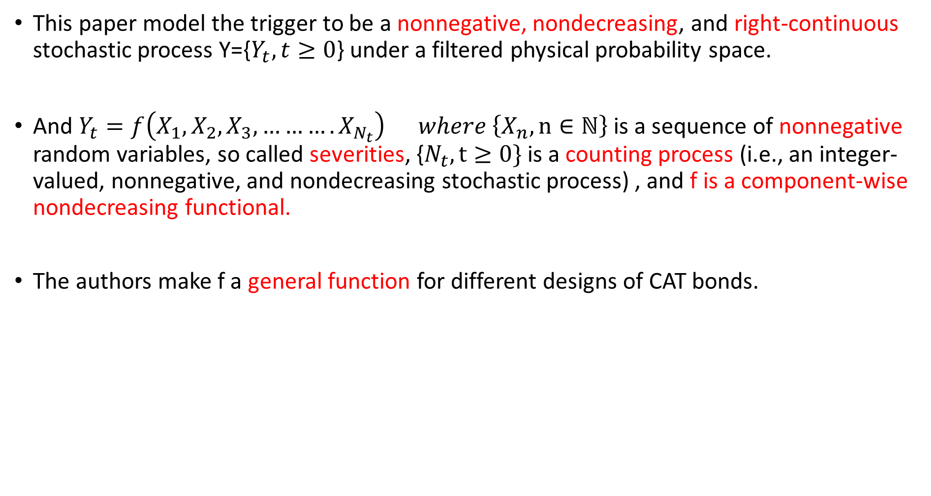
This paper model the trigger to be a nonnegative, nondecreasing, and right-continuous stochastic process Y={$Y_{t}, t≥0$} under a filtered physical probability space.
And $Y_{t}=f\left(X_{1},X_{2},X_{3},……….X_{N_{t}}\right) where \left\{X_{n},n∈ℕ\right\}$ is a sequence of nonnegative random variables, so called severities, {$N_{t},t≥0\}$ is a counting process (i.e., an integer-valued, nonnegative, and nondecreasing stochastic process) , and f is a component-wise nondecreasing functional.
The authors make f a general function for different designs of CAT bonds.

Slide 6
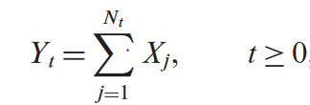

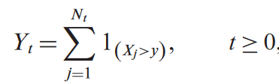
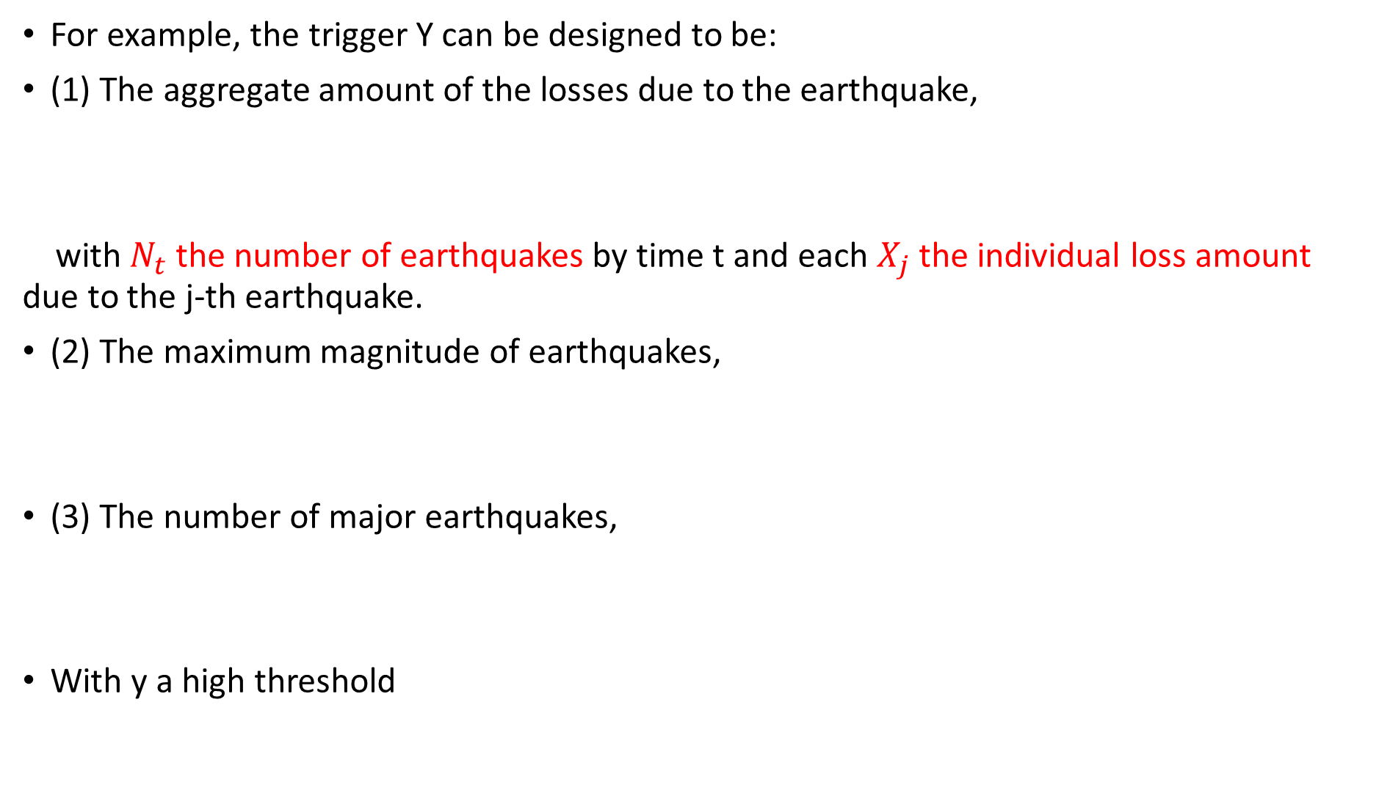
For example, the trigger Y can be designed to be:
(1) The aggregate amount of the losses due to the earthquake,
with $N_{t}$ the number of earthquakes by time t and each $X_{j}$ the individual loss amount due to the j-th earthquake.
(2) The maximum magnitude of earthquakes,
(3) The number of major earthquakes,
With y a high threshold

Slide 7

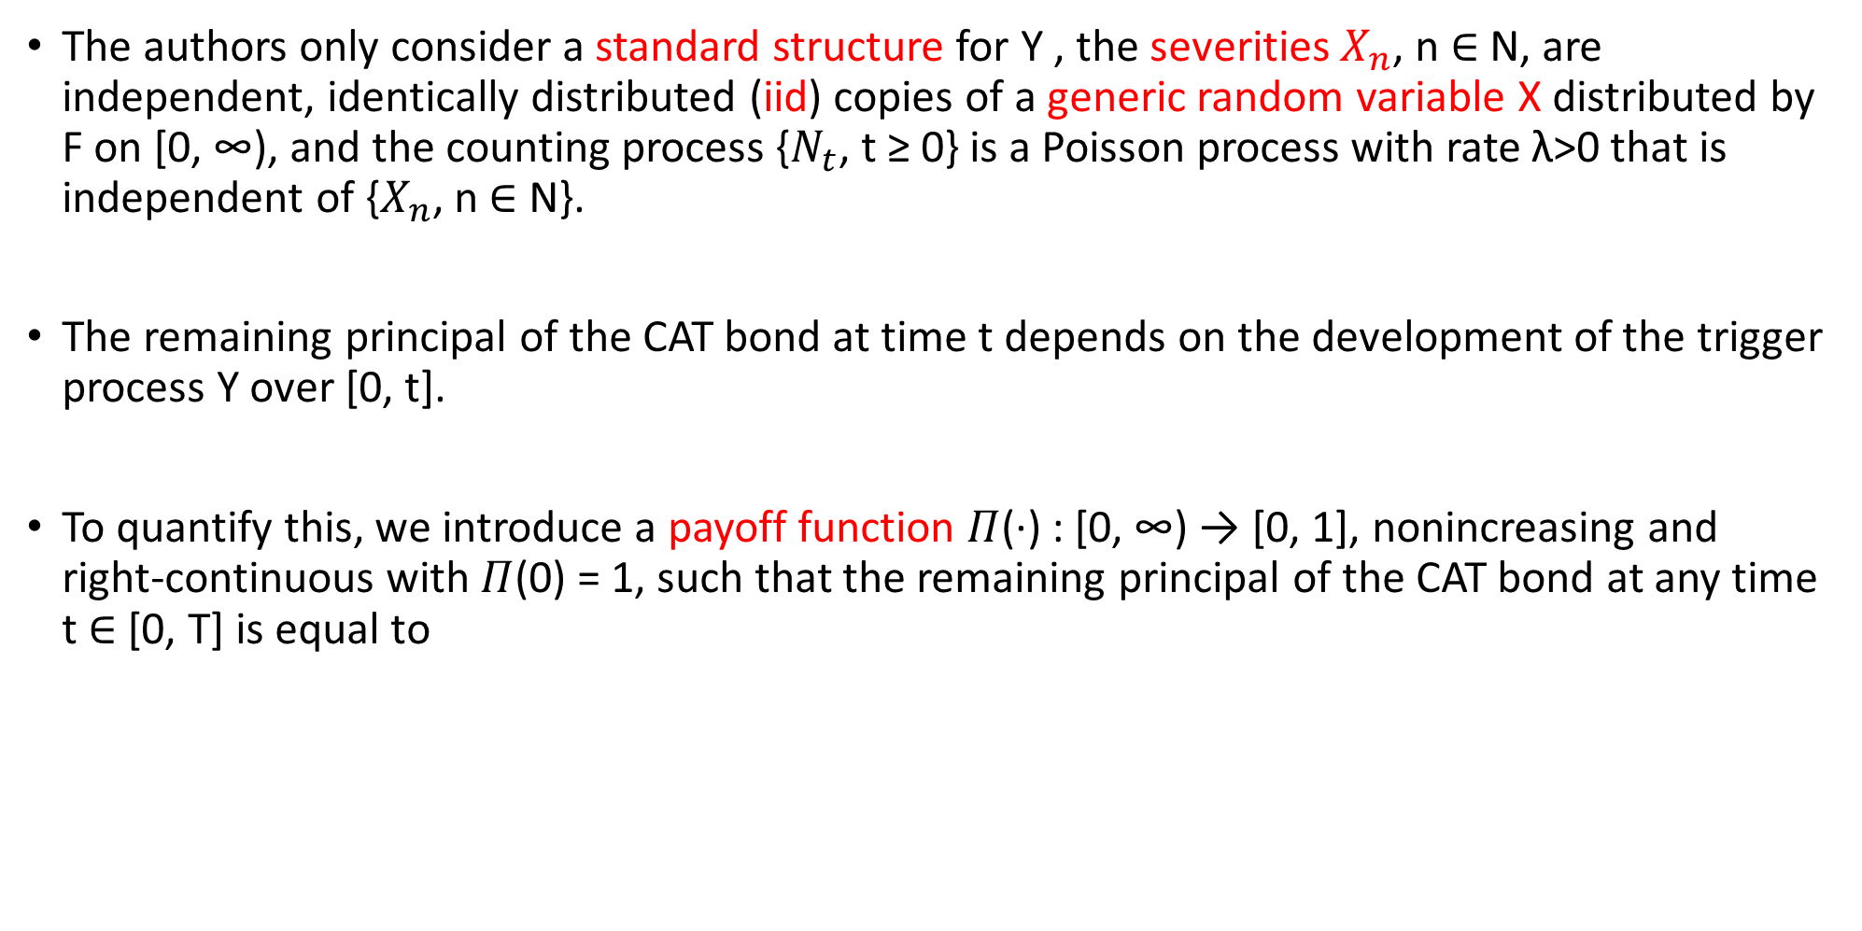
The authors only consider a standard structure for Y , the severities $X_{n}$, n ∈ N, are independent, identically distributed (iid) copies of a generic random variable X distributed by F on [0, ∞), and the counting process {$N_{t}$, t ≥ 0} is a Poisson process with rate λ>0 that is independent of {$X_{n}$, n ∈ N}.
The remaining principal of the CAT bond at time t depends on the development of the trigger process Y over [0, t].
To quantify this, we introduce a payoff function $Π$(·) : [0, ∞) → [0, 1], nonincreasing and right-continuous with $Π$(0) = 1, such that the remaining principal of the CAT bond at any time t ∈ [0, T] is equal to

Slide 8


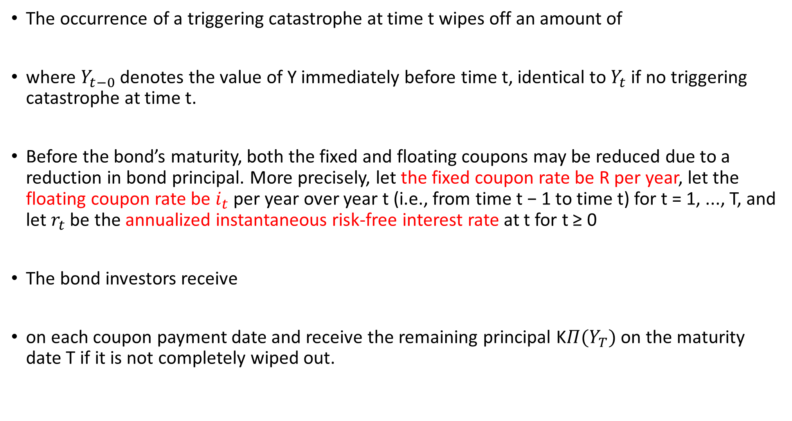
The occurrence of a triggering catastrophe at time t wipes off an amount of
where $Y_{t−0}$ denotes the value of Y immediately before time t, identical to $Y_{t}$ if no triggering catastrophe at time t.
Before the bond’s maturity, both the fixed and floating coupons may be reduced due to a reduction in bond principal. More precisely, let the fixed coupon rate be R per year, let the floating coupon rate be $i_{t}$ per year over year t (i.e., from time t − 1 to time t) for t = 1, ..., T, and let $r_{t}$ be the annualized instantaneous risk-free interest rate at t for t ≥ 0
The bond investors receive
on each coupon payment date and receive the remaining principal K$Π(Y_{T})$ on the maturity date T if it is not completely wiped out.

Slide 9


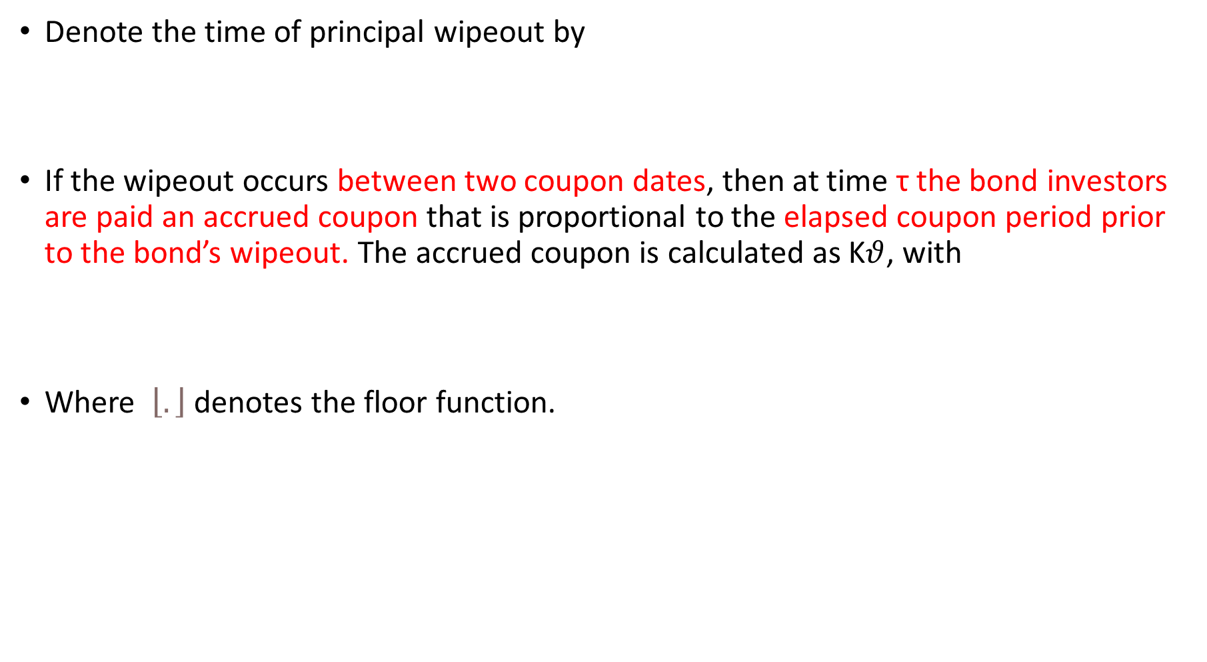
Denote the time of principal wipeout by
If the wipeout occurs between two coupon dates, then at time τ the bond investors are paid an accrued coupon that is proportional to the elapsed coupon period prior to the bond’s wipeout. The accrued coupon is calculated as K$θ$, with
Where $\left\lfloor .\right\rfloor$ denotes the floor function.

